Slide 1
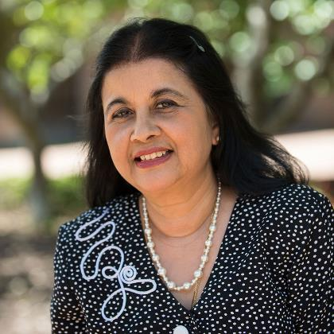
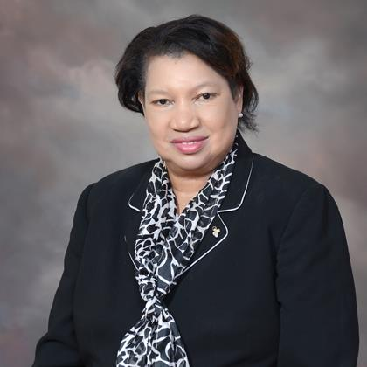


PARTNERSHIP 2020 Promoting Women’s Family-based Entrepreneurship in West Bengal
Welcome from the Claflin University, USA Team Members
DR MITALI WONG DR. PEGGY RATLIFF DR. ABDULLAH KHAN DR. HARPAL S. GREWAL
Professor of English Professor of English Associate Professor of Economics PROFESSOR OF ECONOMICS & Finance
Co-Principal Investigator Project Specialist Project Specialist Co-Principal Investigator

Slide 2
Welcome Message
Dear Business Ladies, Advisory Board Members and all other Ladies and Gentlemen:
On behalf of the entire team of Partnership 2020 Project, I would like to welcome you to the pilot presentations of our Training Program for Entrepreneurship Development for Women in West Bengal. During the next three days, you will review different sections of the program. Please note that the quality of the training program will largely depend on your feedback, suggestions and recommendations.

Slide 3
Therefore, please give us your assessment of the following:
**The language and terms used in the program are simple and easy to understand. Please point out any English or Bengali language words/phrases that are not commonly used.
**Each section of the program is complete, comprehensive, and add to your skills and information.
**The overall program is comprehensive and complete to enhance your business, technology and personal skills as an entrepreneur.

Slide 4
**The program provides you the necessary information for contacts and networking that you need for Path forward as a present or future business-person.
**The overall training program addresses the family-based model for business development. It brings out how different members of the family can work together to help you in your business.

Slide 5
Again, we welcome you to the pilot presentations. Thank you for your time and commitment to assist us in designing the entrepreneurship training programs to improve economic and social conditions, particularly in rural India. We look forward to meeting all of you next year once the Covid-19 subsides, and travel restrictions are lifted.
Best Regards,
Harpal S. Grewal

